Slide 1
Banking App
With JDBC
By Anshul Jaiswal

Slide 2
Table of contents
01
02
03
04
JAVA
JDBC
SCOPE OF THE PROJECT
PROJECT CONFIGURATION

Slide 3
Table of contents
05
06
07
08
DEPENDENCIES
FUNCTIONAL REQUIREMENTS
OPERATING ENVIRONMENT
HIERARCHY OF PROJECT ARTIFACTS

Slide 4
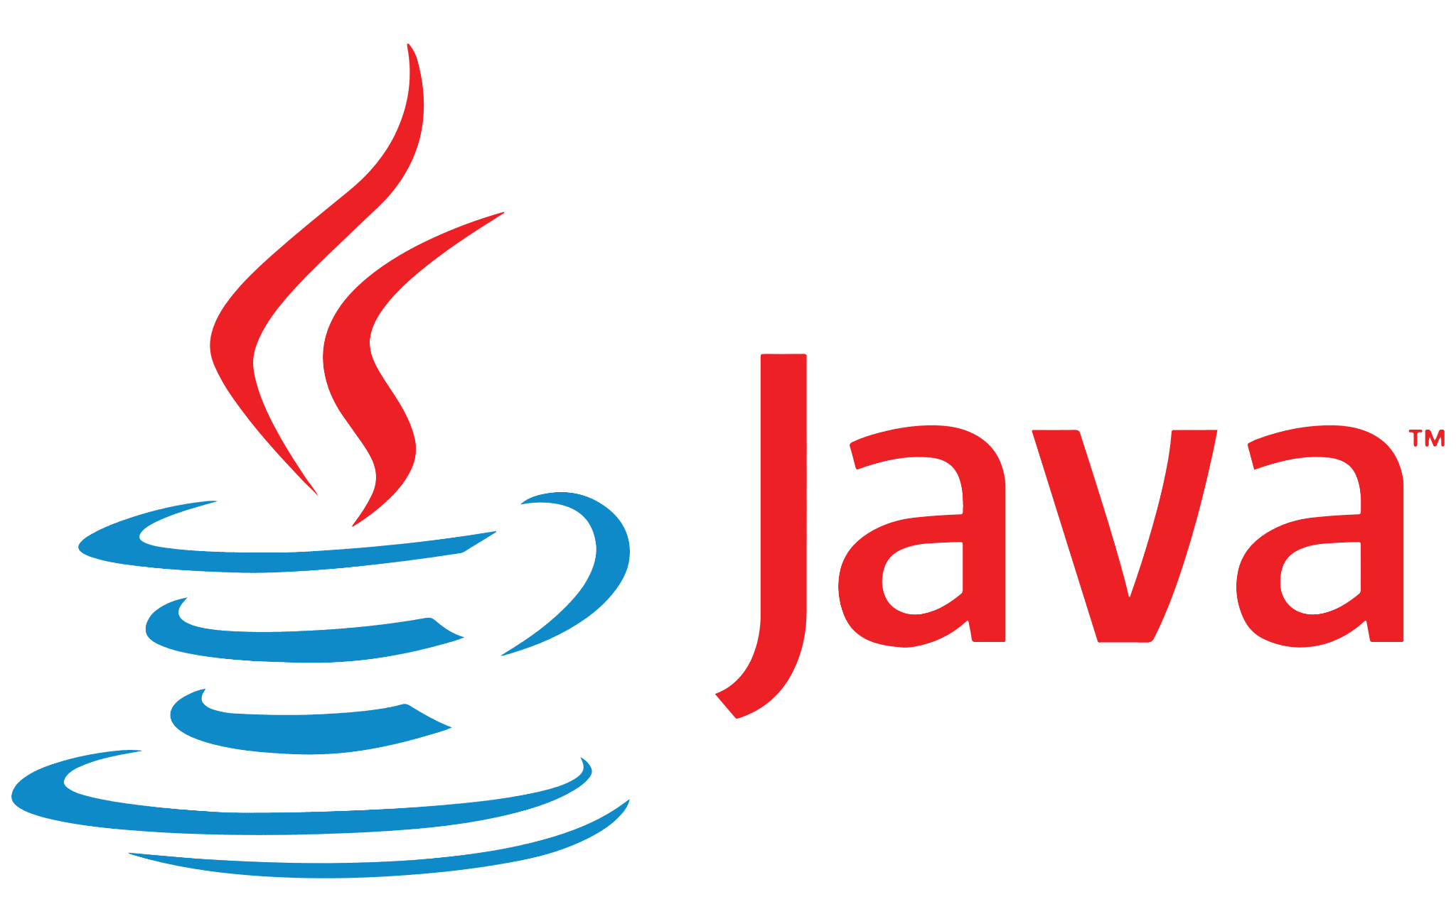
Java
Java is a versatile and widely-used programming language known for its portability, simplicity, and robustness. Developed by Sun Microsystems (now owned by Oracle), Java was introduced in the mid-1990s and has since become a prominent language in various domains, from web development to enterprise applications, mobile applications (Android), and embedded systems.
One of Java's key features is its "write once, run anywhere" (WORA) principle. Java programs are compiled into an intermediate form called bytecode, which can be executed on any device with a Java Virtual Machine (JVM).
This enables developers to create applications that are platform-independent, allowing them to run seamlessly on different operating systems without modification.

Slide 5
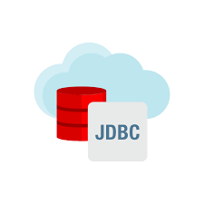
JDBC
Java Database Connectivity (JDBC) is a crucial component of the Java Standard Edition (Java SE) platform, providing a standardized Java API (Application Programming Interface) for database connectivity. JDBC allows Java applications to interact with relational databases, facilitating the management of database operations, such as querying, updating, and modifying data.
A typical JDBC workflow involves loading the JDBC driver, establishing a connection to the database, creating and executing SQL statements, handling result sets, and managing transactions.

Slide 6
Scope of the Project
Objectives:
Design and implement a Java project to process Bank Transactions using data from the “BankTrans” table. The system will update the “NewBal” and “TransStat” columns based on the transaction information and validity. Furthermore, it will also log the transaction information into the “ValidTrans” and “InValidTrans” tables.
Features:
Fetching transaction data from the BankTrans table.
Updating “NewBal” column based on the formula:
NewBal = OldBal (+-) TransAmt
Determine TransStat based on the calculated NewBal
Insert valid transactions into the ValidTrans table and invalid transactions into the InValidTrans table.

Slide 7
Scope of the Project
Components:
Java Code: Used for data retrieval and transaction processing. Also ensures error handling and security.
BankTrans Table: Contains the transaction information
ValidTrans Table: Contains the Valid transactions.
InValidTrans Table: Contains the Invalid transactions.

Slide 8
Project CONFIGs
Ojdbc14.jar : Right click on the project -> Properties -> Java Build Path -> Libraries ->Add External JARs -> Locate Ojdbc14.jar -> Apply and Close.
OracleDriver : We will load the database driver using the following line:
Class.forName("oracle.jdbc.driver.OracleDriver");
Here, forName() is a static method of class “Class”
tnsnames.ora : The port number and service name is present in tnsnames.oral. Each entry in the tnsnames.ora file consists of a connect identifier and its associated connect descriptor. We replace CONNECT_IDENTIFIER, host, port, and service_name with our specific values.

Slide 9
Project CONFIGs
Database URL : jdbc:oracle:thin:@localhost:1521:XE
Here, jdbc is the API,
Oracle is the database,
Thin is the database driver type,
@localhost if the IP Address of the machine
1521 is the port number on which oracle is listening as an application
XE is the service name
Establishing Connection: We will create a connection to database using Driver.Manager.getConnection();

Slide 10
Dependencies
Ojdbc14.jar
OracleDriver
tnsnames.ora
It contains the Oracle JDBC driver classes for Java applications to connect to Oracle databases. Each version of the Oracle JDBC driver is typically associated with a specific Oracle Database release.
It is a class provided by the Oracle JDBC driver, and it serves as a bridge between Java applications and Oracle databases. It plays a crucial role in establishing a connection between a Java application and an Oracle database.
The tnsnames.ora file is a configuration file used by Oracle Database clients to resolve Oracle Net Services connect identifiers to connect descriptors. In simpler terms, it is a file that helps Oracle clients find and connect to Oracle databases on a network.

Slide 11
Components
This class contains the main() method as well as all the other methods used to update and insert values in the tables
BaseClass:
BankingProject{
}

Slide 12
Utility Methods
main()
updateNewBal()
insertValidity()
Used to read the rows in BankTrans table and invoke methods to update the data.
Used to Update the
NewBal and TransStat columns in the BankTrans table.
Used the insert the transaction data in the ValidTrans and InvalidTrans tables depending on the validity.

Slide 13
Method Chaining
Method Chaining is the practice of calling different methods in a single line instead of calling other methods with the same object reference separately.
Under this procedure, we have to write the object reference once and then call the methods by separating them with a (dot.).

Slide 14
Method Chaining
main()
Update columns
in BankTrans
Insert rows in ValidTrans and InValidTrans Tables
updateNewBal()
Call
Method
Call Method
insertValidity()

Slide 15
Requirement ID | Requirement Category | Requirement Type | Priority | Hierarchy | Ref
R001 | Functional | Stated | High
Requirement Description | Establishing Database Connection
Scope | Entire Project
Requirement Methodological Details | We have to establish connection with database first in order to read the values from the tables as well as update and insert values into them.

Slide 16
Requirement ID | Requirement Category | Requirement Type | Priority | Hierarchy | Ref
R002 | Functional | Stated | High
Requirement Description | Reading the values from the BankTrans table
Scope | Entire Project
Requirement Methodological Details | We have to read the values using the SELECT statement first so that we can update the NewBal and TransStat columns accordingly.

Slide 17
Requirement ID | Requirement Category | Requirement Type | Priority | Hierarchy | Ref
R003 | Functional | Stated | High
Requirement Description | Updating NewBal and TransStat columns in the BankTrans table.
Scope | Entire Project
Requirement Methodological Details | We have to update the NewBal column according to the formula: NewBal = OldBal (+ -) TransAmt. Furthermore, we have to update the TransStat column as “Valid” or “Invalid” depending on the validity of the transaction.

Slide 18
Requirement ID | Requirement Category | Requirement Type | Priority | Hierarchy | Ref
R004 | Functional | Stated | High
Requirement Description | Inserting rows in ValidTrans and InValidTrans tables.
Scope | Entire Project
Requirement Methodological Details | After we have updated the columns in the BankTrans table, we have to insert rows in the “ValidTrans” and “InValidTrans” tables depending on the validity of the transactions.

Slide 19
Operating Environment
APIs
Operating System
Oracle JDBC
Microsoft Windows
Database
Programming Language
Oracle SQL
Java

Slide 20
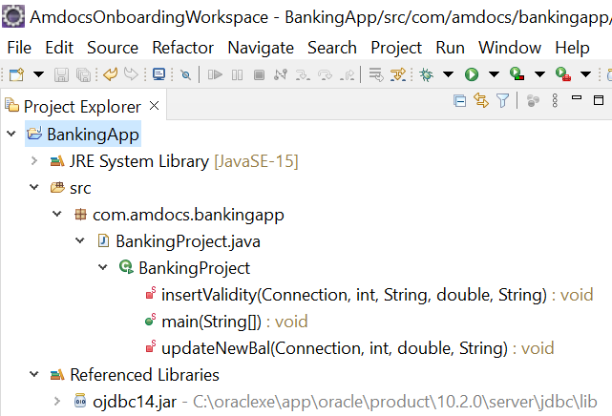
Hierarchy of Project Artifacts

Slide 21


Thank You
By: Anshul Jaiswal
202651

